Slide 1

Online Food Delivery
CSI1007 – Software Engineering Principles
Laboratory
23MID0088
23MID0003
23MID0169
VIT - SCOPE - SEP LAB - VL2024250503896 - L35+L36

Slide 2
Online Food Delivery
DESCRIPTION:
To develop and launch a user-friendly and scalable online food delivery platform that enables restaurants to expand their customer base and customers to enjoy convenient online ordering and table reservations. The platform will provide a seamless delivery experience with secure payment processing and efficient order management, ensuring satisfaction for both customers and restaurant partners.
Scope:
The scope of a food delivery website includes user registration, restaurant listings, search and filters, order placement, and real-time tracking. It integrates secure payment options, promotions, and discounts while providing effective customer support. The platform ensures scalability, supports multiple restaurants, and offers an admin dashboard for managing users, orders, and analytics, delivering convenience and efficiency for all stakeholders.

Slide 3
Impact :
The project boosts restaurant revenue, creates new income streams, enhances customer satisfaction, and improves order management efficiency. Socially, it generates jobs for delivery partners and supports local businesses. Technologically, it promotes online ordering and delivery systems, fostering innovation in the food service industry and driving the adoption of advanced technologies for seamless operations and customer convenience.

Slide 4
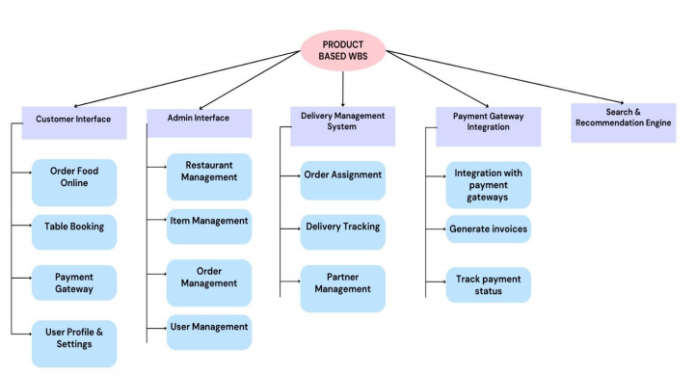
Work Breakdown Structure

Slide 5
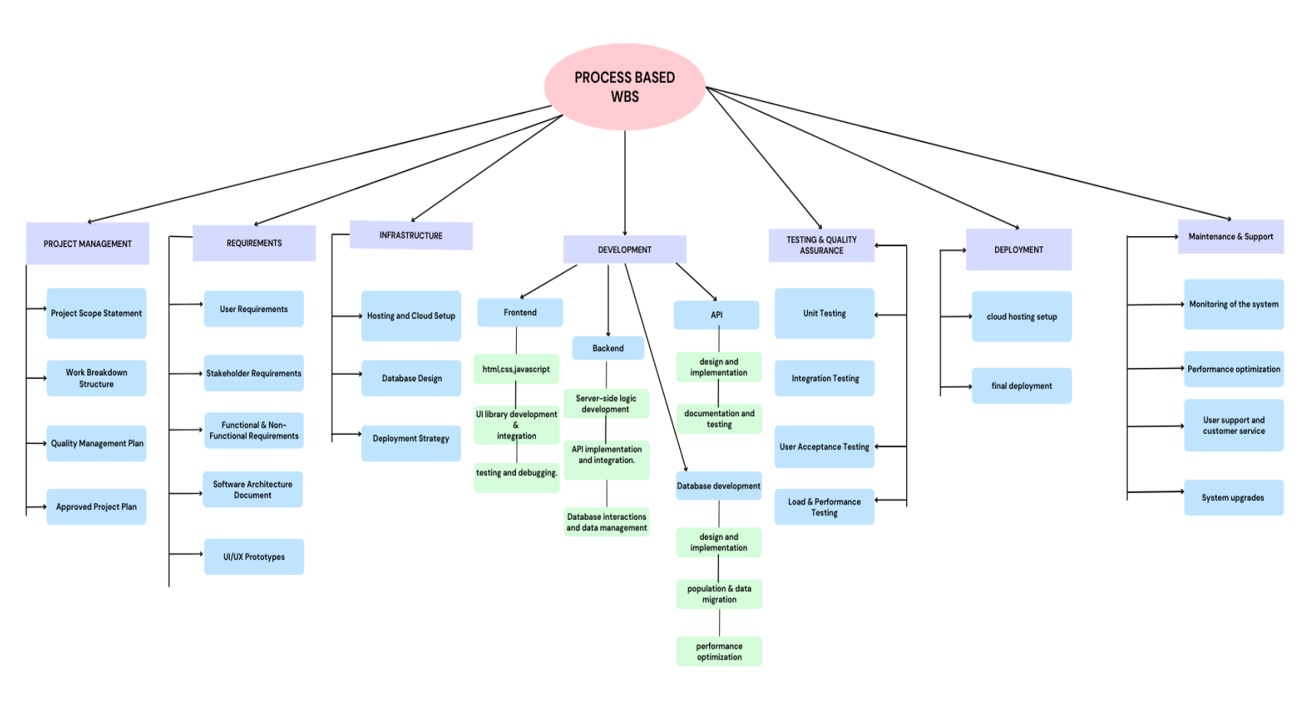

Slide 6
Functional Requirements:
User and Restaurant Management: Support user registration, login, profile management, and restaurant menu updates.
Search and Order Placement: Enable searching for restaurants or dishes, applying filters, and placing orders with customization options.
Table Reservations and Delivery: Provide table booking and real-time order tracking for delivery or pickup.
Secure Payment Processing: Offer multiple payment methods with detailed order summaries and confirmations.
Reviews and Notifications: Allow users to rate restaurants, write reviews, and receive notifications for updates or promotions.
Admin Panel and Support: Provide an admin dashboard for system management and customer support for issue resolution.

Slide 7
Nonfunctional Requirements
5.1 Performance Requirements
The system must process up to 1,000 orders per second with minimal delays,
ensuring fast order processing and quick response times even during peak traffic.
5.2 Safety Requirements
Ensure customer data privacy: Customer information (e.g., name, address, payment
details) must be securely stored and only accessible by authorized personnel,
following privacy standards like GDPR.
5.3 Security Requirements
Use HTTPS for all communications:
All data exchanged between the system and users must be encrypted using HTTPS to
protect against unauthorized access or tampering.
5.4 Software Quality Attributes
Usability: Simple navigation:
The system must have an easy-to-use interface with clear menus and options,
allowing users to complete tasks quickly without confusion.

Slide 8
UML - Diagrams
Use case diagram
Class diagram
Sequence diagram

Slide 9
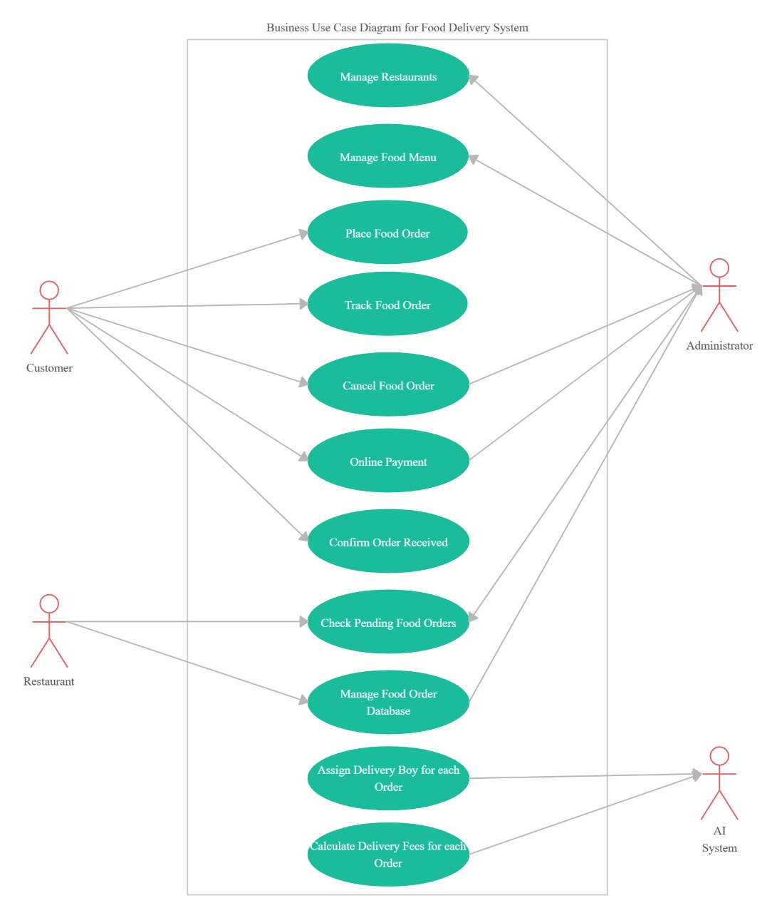

Slide 10
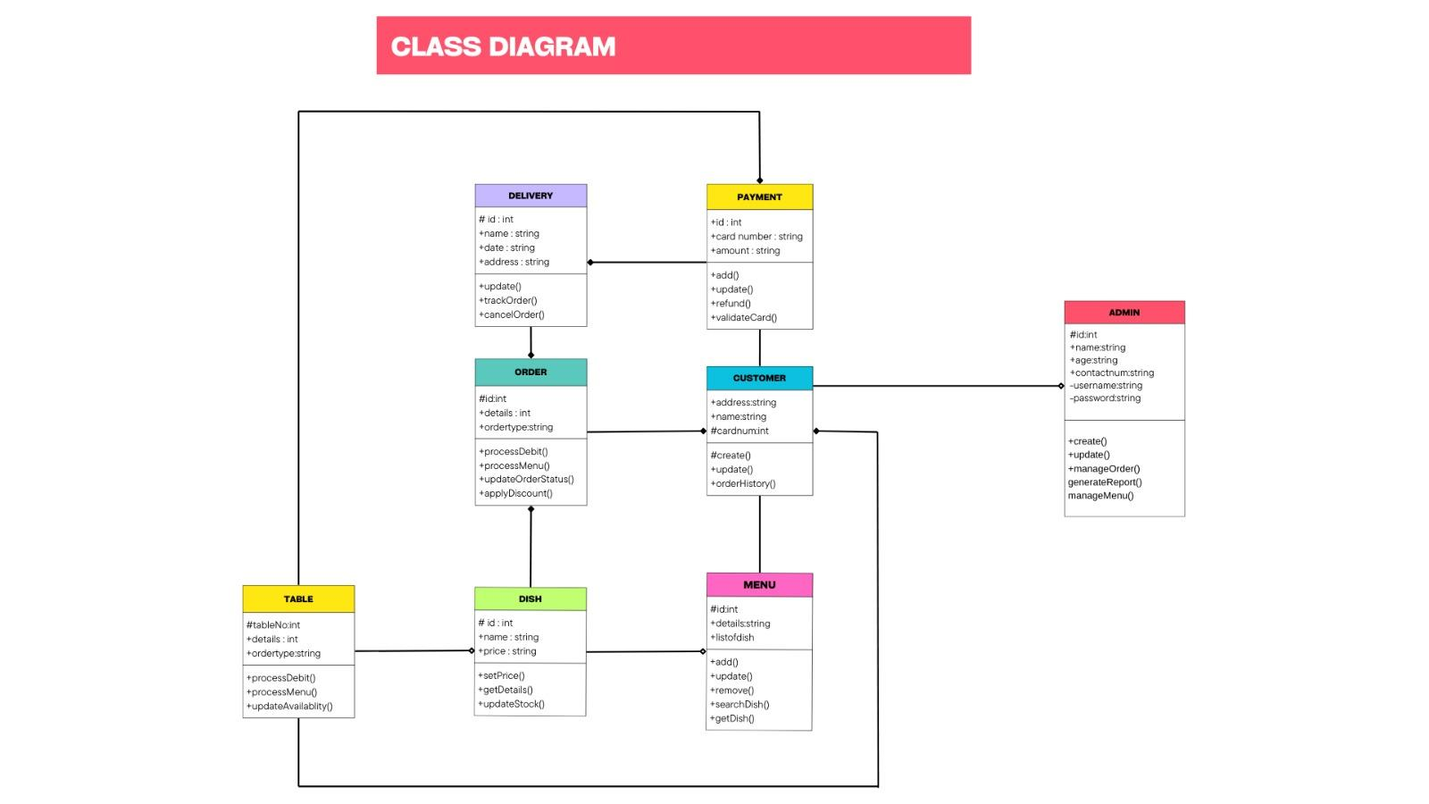
Class diagram

Slide 11
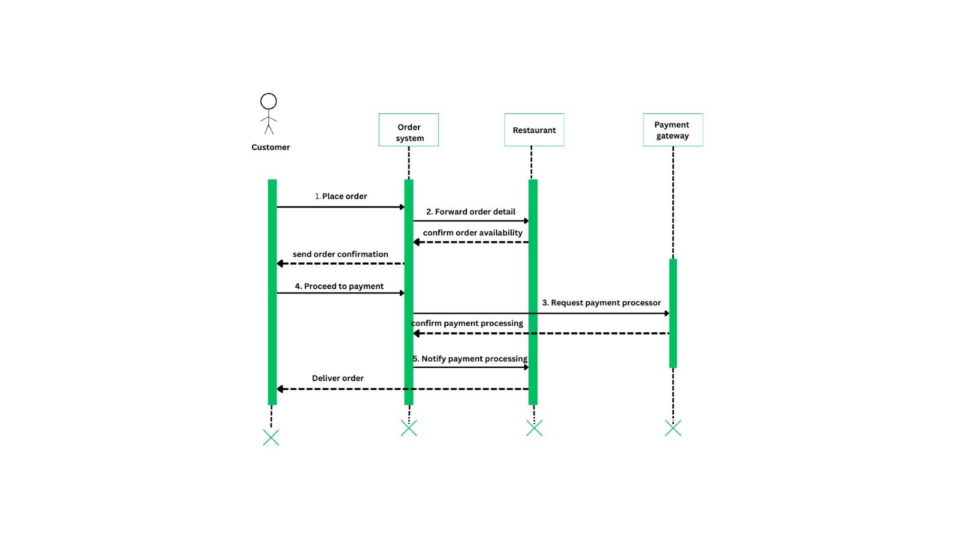
Sequence diagram-payment process

Slide 12
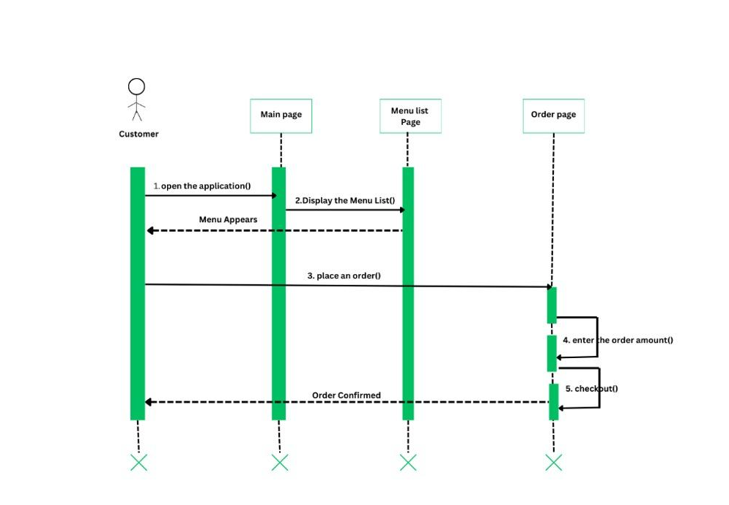
Sequence diagram-place an order

Slide 13
Comprehensive Test Case- Login / Registration
Test Scenario: Verify login and registration functionality with valid and invalid inputs.
Test Case Description: Ensure that the system allows new users to register successfully and existing users to log in with valid credentials while rejecting incorrect inputs.
Test Steps
Login Test Case
Open the login page.
Enter a username.
Enter a password.
Click the "Login" button.
Registration Test Case
Open the registration page.
Enter a new username.

Slide 14
Enter a valid email.
Enter a secure password.
Confirm the password.
Click the "Register" button.
Test Data
Valid Case (Login)
Username: testuser
Password: Pass@123
Invalid Case (Login)
Username: wronguser
Password: wrongpass
Valid Case (Registration)
Username: newuser
Email: newuser@example.com
Password: Secure@123
Confirm Password: Secure@123

Slide 15
Invalid Case (Registration)
Username: (empty or less than required characters)
Email: invalid-email-format
Password: weakpassword
Confirm Password: mismatchpassword
Test Expected Result
Login:
If valid credentials are entered, the user should be redirected to the dashboard.
If invalid credentials are entered, an error message "Invalid Username or Password" should appear.
Registration:
If valid details are entered, the system should successfully create an account and redirect the user to the login page.
If invalid details are entered, appropriate error messages should appear, such as:
"Invalid email format"
"Password must be at least 8 characters long"
"Passwords do not match"

Slide 16
Actual Result
Login:
Valid credentials: Redirected to the dashboard.
Invalid credentials: Got an error message "Invalid Username or Password."
Registration:
Valid registration: Account created successfully, redirected to login.
Invalid registration: Error messages displayed as expected.
Pass/Fail: Pass ✅

Slide 17
Comprehensive Test Case- Order Tracking
Test Case ID: TC002
Test Scenario: Verify the order tracking functionality for valid and invalid cases.
Test Case Description: Ensure that the system allows users to track their orders in real-time with accurate status updates and prevents unauthorized access to tracking details.
Test Steps
Valid Order Tracking Case:
Place an order successfully.
Navigate to the "Track Order" page.
Enter the valid order ID or access tracking from the order history.
Observe the real-time tracking status.
Invalid Order Tracking Case:
Navigate to the "Track Order" page.
Enter an invalid order ID.
Check if the system handles invalid input correctly.

Slide 18
Network Failure Case:
Open the "Track Order" page.
Disconnect from the internet.
Refresh the page and check the system behavior.
Test Data
Valid Case:
Order ID: 12345 (Existing valid order)
Invalid Case:
Order ID: 99999 (Non-existent order)
Network Failure Case:
Disconnect internet while tracking the order.

Slide 19
Test Expected Result
Valid Order:
The order tracking page should display real-time updates (e.g., "Preparing", "Out for Delivery", "Delivered").
The map should show the delivery partner's live location.
Invalid Order:
An error message "Order Not Found" should appear.
Network Failure:
A message like "No Internet Connection. Please try again later." should appear.
Actual Result
Valid Order: Order status updates correctly, and the map displays the real-time location.
Invalid Order: Displays "Order Not Found" error message.
Network Failure: Shows a "No Internet Connection" message.
Pass/Fail: Pass ✅

Slide 20
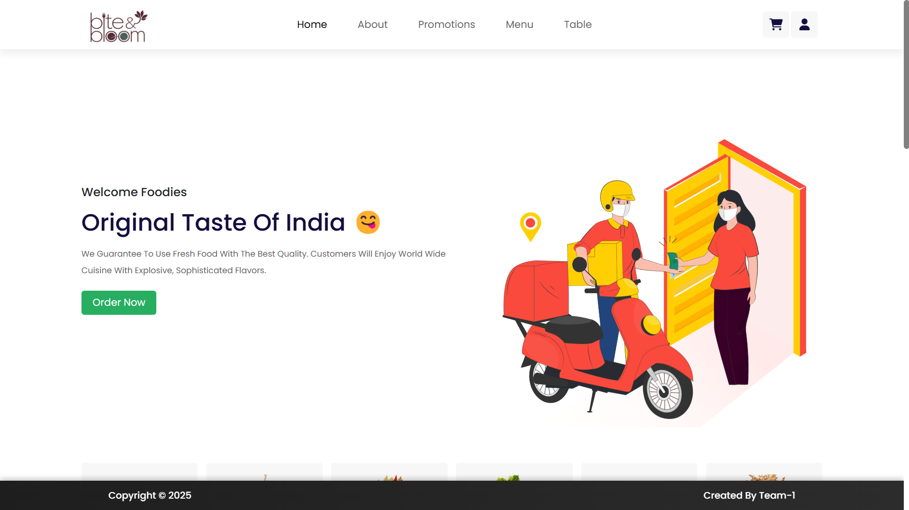

Slide 21
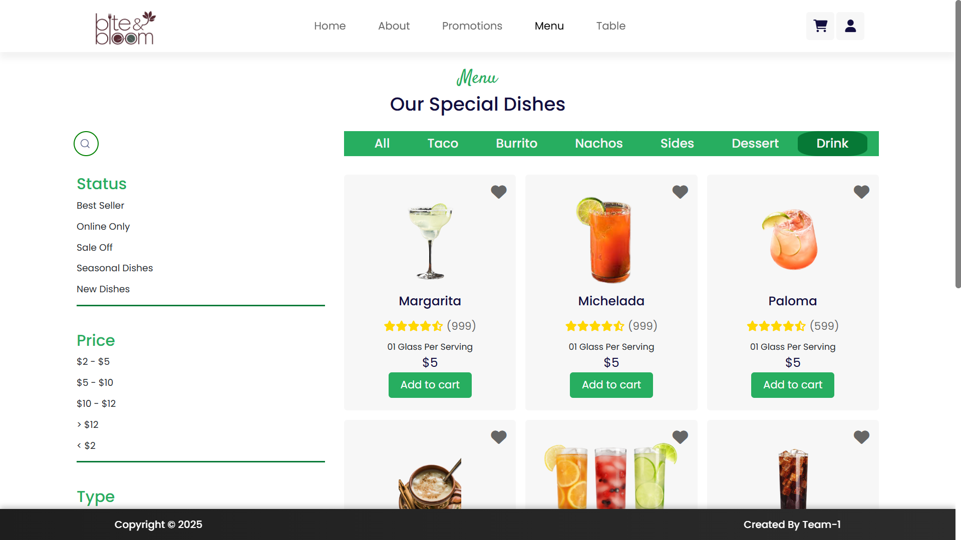

Slide 22
